Slide 1
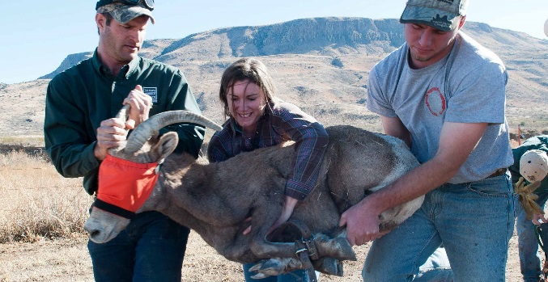
Wildlife Technician
Student’s name here

Slide 2
Job Description
Tracking and catching animals
Monitoring wildlife health and habitats
Help scientists collect data on wild animal populations
Catch and tag animals. This way they can track the migratory routes
Collect blood samples to analyze.
Sometimes they check for health issues or disease
Keep a careful record of what they do in the wild

Slide 3
Working Conditions
Often work for government agencies
Extreme weather conditions (heat, snow, rain)
Be able to handle large animals (lions)
Might to live in tents for periods of time
Be able to operate boats, four-wheel trucks, and quads
40-hour week (normally)
Must be expendable depending on what you are tracking

Slide 4
Education Needed
Depends on what position you want
Wildlife and Wild land management (associates degree--2 years)
For senior positions you need a bachelor's degree (4 years)

Slide 5
Training Needed
There is no specific licenses or certifications that I could find for this specific job.
As long as you have the correct degrees you can probably be a wildlife technician.
You might need certain certifications if you are going into certain areas while tracking an animal.

Slide 6
Sample career path
Things like salary and hours vary depending on your level of expertise. This is an example of a full time wildlife technician
Pay—25,000 to 30,000
Requirements—an associate’s or bachelor’s degree, experience in wildlife travel (preferred), volunteer experience.
Responsibilities—being out in the field, monitoring wildlife populations, collecting samples, testing samples (in the lab), researching, developing procedures, writing reports, and organizing projects.

Slide 7
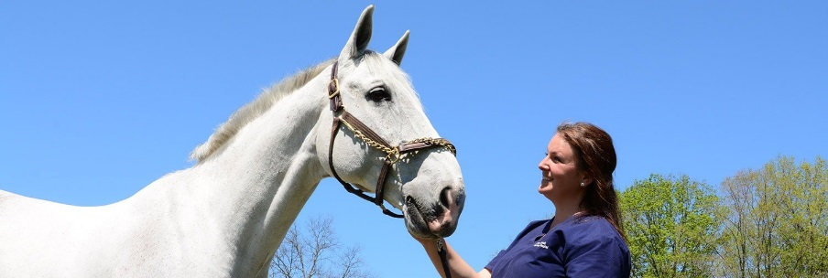
Related Careers
Not everything always goes exactly as planned.
You might go to school hoping to be a wildlife tech and not have it work out.
Don’t worry! There are plenty of other options such as; veterinarian, horse trainer, zoologist, forest firefighter, agricultural technician, and animal breeder.

Slide 8
What do the employees have to say?
How did you get into your job? (Francis)
I had to go to college for his bachelor’s degree. While I was attending I did volunteer work.
What traits do you need to be a wildlife tech? (Francis)
You need to be a person that can multitask easily. You have a lot of things coming at you really fast.

Slide 9
Classes you should take in High school
Following are the recommended classes, for each grade, other than the ordinary if you want to go into the wildlife tech field.
Ninth Grade—Technology
Tenth Grade—Biology, Communications & Technology Applications
Eleventh Grade—Biology, Chemistry, Earth and Environmental Science
Twelfth Grade—Biology, Anatomy & Physiology, Earth & Environmental Science

Slide 10
Job outlook
This job is working in either a lab or out in the field, tracking and monitoring wildlife populations.
To qualify for this job you need to be athletic, good with animals, and able to adapt to new situations.

Slide 11
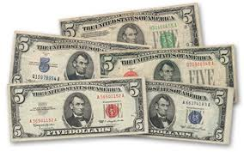
Salary
As noted before, your salary depends on your level of expertise.
Here is the hourly and annual salary for three different levels:
Entry Level—Hourly/$13.72—Annual/$28,540
Median Wage—Hourly/$15.85—Annual/$32,970
Experienced Wage—Hourly/$19.03—Annual/$39,580

Slide 12
Typical day on the job
The following is Francis’ daily schedule:
7-8—open the office, get the lake elevation, record a daily lake level for the public
8-9—respond to e-mails and phone calls, catch up on paper work
9-12—Cut down and clean up hazardous tree in the walking trail
12-1—Lunch
1-3—Rake fire lines for prescribed burn
3-5—Work with volunteers for the shoreline cleanup project
5-15—Go home
Of course the schedule is a little different for someone who works in the office.

Slide 13
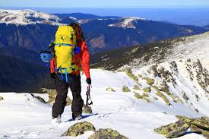
Type of attire for the job
The clothing you wear depends totally on the weather.
For every season except for winter you need; Rain gear, knee high muck boots, hiking boots, hip waders, and field pants (canvas, good jeans)
For winter you need; Winter parkas, hand/toe warmers, thermal underwear, ski pants, gloves or mittens, heavy socks, and face mask/scarf

Slide 14
What type of person do you need to be for this job?
You need to be; good on your feet, able to operate equipment, can work outside in any weather, good at working with animals, don’t care if you get dirty, good at lifting or carrying heavy things, and being able to write and express your ideas.

Slide 15
What I learned
I didn’t realize that there was so much desk work that you could do and that you would have to work so much with people instead of just animals.

Slide 16
Sources
http://salmonbrookvets.com
https://www.facebook.com/Alma-High-School-445589592286556/
https://www.govmint.com/1928-1963-5-dollar-bill-collection-5-pieces
https://www.theactivetimes.com/gear/hiking-camping/best-hiking-gear-winter
https://umaine.edu/wle/undergraduate-program/list-of-suggested-field-gear/
https://www2.careercruising.com/careers/suitable-for-you/736
https://tpwd.texas.gov/jobs/wildlife/
http://michiganradio.org/post/nassars-former-boss-msu-arrested-ingham-county
https://www.tastemade.com/videos/ice-cream-cone-cupcakes
https://encrypted-tbn0.gstatic.com/images?q=tbn:ANd9GcTBr2Z43UFJ9MUtztEj6Qf9dYg0N9GyIixNDAZ0Tm_zfPguwm_8

Slide 17
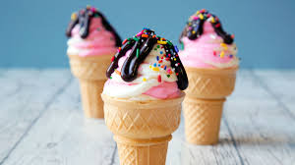
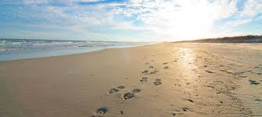
Have a great summer! Thank you

