Slide 1
Healthcare Administrator
By: student name

Slide 2
Job Description
Generally health care administrators work to minimize cost and maximize efficiencies, while also insuring the services provided are the best possible.
They must keep up to date on changing federal state laws and state laws governing health care.

Slide 3
Working Conditions
Health care administrators usually work for 40 hours a week
There may be time longer than others. Since the medical field that they work for operate around the clock.
A manger might be called in at all hours to deal with issues.

Slide 4
Education
Bachelor’s Degree in public health
Master’s in nursing is most efficient for entry level positions or for employment with smaller facilities when coupled with relevant health care experience, hospital or business administration

Slide 5
Training needed for a health care administrator
Must pass the national association of long term health care administration board exam.
obtain state licensure.
Health Care administrators in other sectors are not required to be licensed; however voluntary certification is available through the American college of healthcare administrator.

Slide 6
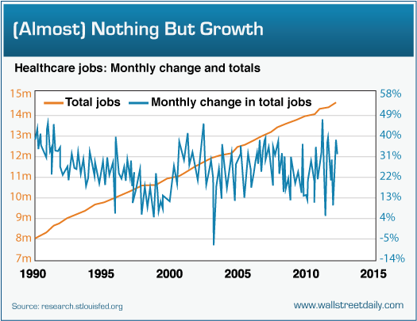
Job Outlook
The Job outlook for health care administrator is good.
the BLS projecting a 17% growth through 2024, much faster than average jobs.
Aging baby boomers will spur demands across the entire health care industry, creating the need for more health administrators.

Slide 7
Salary
The median annual salary for the administration field was 96,540 in May 2016
Average pay for administrators that work in hospitals was 117,630
those in doctor office averaged 105,149

Slide 8
Attitudes, employability skills, and work skills necessary to do this job well
Communication and relationship management
Leadership
Professionalism
Knowledge of health care environment
Business skills and knowledge

Slide 9
Colleges that have programs for healthcare administration
A.T. still university
Academy College
Miami- job career
Adventist University of health services
Alabama State University

Slide 10
Suggested High School Classes
English
Mathematics
Biology
Physical sciences
Law and Government
Office administration
Economics
Key boarding

Slide 11
Sources
https://www.collegesanddegrees.com/programs/healthcare-administration
https://programs.online.utica.edu/articles/core-competencies-for-a-healthcare-administrator
https://www2.careercruising.com/careers/sample-career-path/208

