Slide 1
STUDENT NAME
Farming

Slide 2
Descriptions about Farming:
Framing is a high-tech industry that uses complex machinery.
Farmers can grow a many crops such as corn, wheat, and soy beans.
Farmers don’t just have to grow crops you can raise livestock if you want.

Slide 3
Working Conditions:
Farmer have a variety of different farms. Which means different type of work.
On average a farmer works about 9 hours a day for seven days. This means a farmer works over 60 hours a week.
Farmers that work alone don’t have mush vacation time, but if you have hired help you can squeeze in about two weeks.
Farmers walk or run most of the day.

Slide 4
Education:
You don’t need formal training to be a framer.
You may might want to get into soil science, farm equipment mechanics, and animal care.
Most farmers start off being a son or daughter to a farmer, so they mostly learn from them.
Others will work on nearby farms then go start a farm on there own.

Slide 5
Salary:
The general manager of a farm makes from less than 35,000 to over 125,00 a year.
Hired hands make 9 to 19 dollars an hour, this can add up to 39,00 a year.
People who rent land out to farmers can make less than 20,000 to 125,000 a year.
Entry wage: Hourly- 25.35 Annual- 52,720
Median wage: Hourly- 29.34 Annual- 61,020
Experienced wage: Hourly- 34. 57 Annual- 71,910

Slide 6
Training needed for a Farmer:
There are many certifications, license, etc., for different types of farms so I’m only going list a few.
You may need Nutrient Management Plans, Pesticide Applicator Certification, Soil Conservation Plans, Agriculture Property Assessment, Organic Certification, and Building Permits for Farm Structures, are just a few.

Slide 7
Attire/A Typical Day on the Job:
A typical day on the job starts at 6:00 o’clock in the morning. (Get up☺)
In the winter you must get up way before the sun rises, so you plan your day out and can make sure the work gets done.
In the spring most farmer are out tilling the land and harvest in fall. Winter you clean stalls, feed the animals, and repair the equipment.
Most farmers wear jeans with a t- shirt in the summer and in the winter, snow pants that cover up to the shoulders with long a sweatshirt.

Slide 8
Interviews:
So Dave has been a farmer since he was a little boy, because his father was one.
Dave lives on a dairy farm, so he has to make a crop to feed animals so they get big.
Dave says his biggest challenge is finding good employees even if he live on a farm with 5,000 cows.

Slide 9
Suggested high school classes:
You want to take biology at least once maybe twice.
Law and Government is another you may want to take just to get used all the rules and such.
Technology is listed for all four years and this might a good choice just so you can keep up with the new types of technology that controls the tractors, combines, and feeders even.

Slide 10
College programs:
Michigan State has most of the programs but not Agricultural Production Operations, General
Michigan State is the best college out there for these types of programs.

Slide 11
Why it’s a good match for me:
I have wanted to be a farmer since the first day I saw a tractor plowing the flied.
The first time I got to ride in one, you should have seen my smile.
Now I don’t remember everything I did but I remember sitting out on my silver barn and watching them plowing and harvest the flied.
I’ve worked on a farm out in Breckinridge and I’ve learned a lot.
I think it’s a good match for me because I’m hard working and will hopefully figure out a way to feed the world.

Slide 12
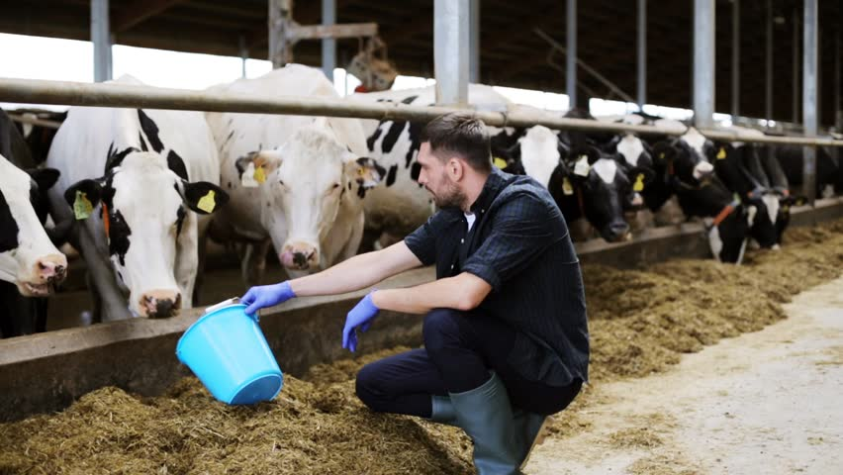
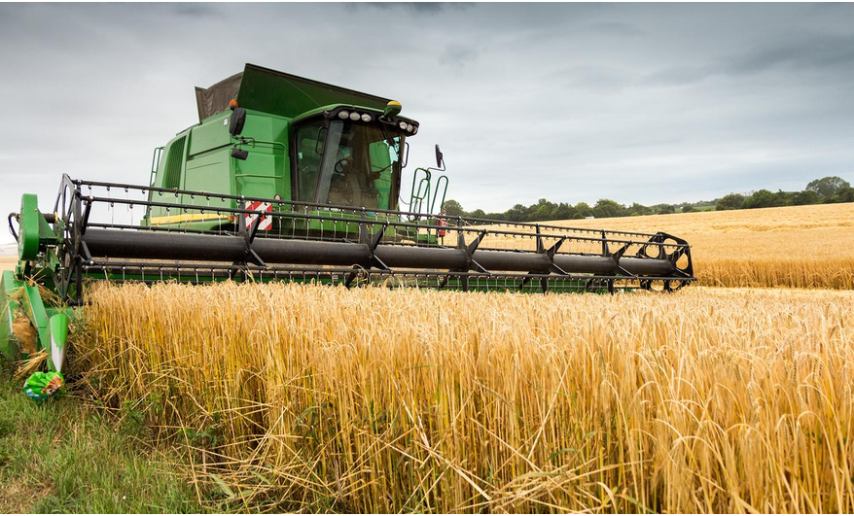
People Farming:

Slide 13
Sources:
https://www2.careercruising.com/careers/profile-at-a-glance/177
http://extension.umd.edu/sites/extension.umd.edu/files/_docs/programs/newfarmer/Guidebook/Common%20Farm%20Licenses,%20Permits%20and%20Certifications.pdf

