Slide 1
Watch this slideshow.
Now…
Find and click F5 on keyboard … then click anywhere on the slide each time you are ready to go to the next slide.
…or…
Click the “start slideshow” button at top left … then click anywhere on the slide each time you are ready to go to the next slide.
Split your screen so it shows this slide show and your Paint window.
Complete the steps in Paint as you read each slide.

Slide 2
This powerpoint is a good intro to paint.
But, it’s from an older version (of paint) so the buttons will differ somewhat.

Slide 3

Microsoft Paint Tutorial
Microsoft Windows 2013
Adapted and updated by M.Maz from original created by: Zaiba Mustafa

Slide 4
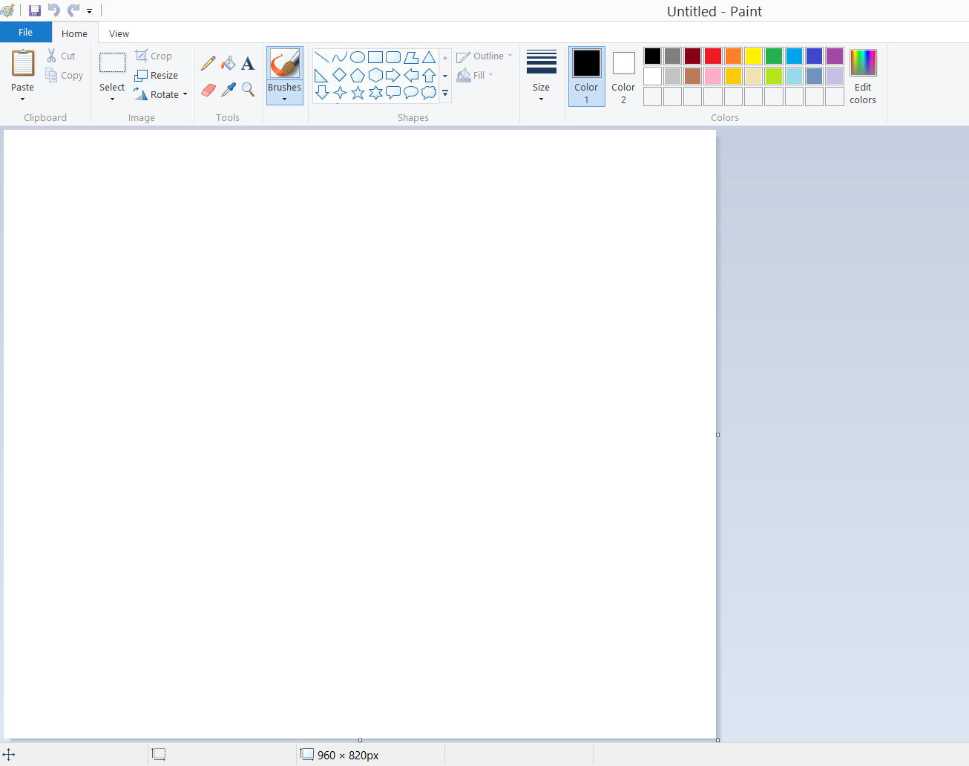

Launch Microsoft Paint
Go to: Start – All Programs - Accessories - over to the Paint icon, and click on it. Paint will then launch, opened to a new (blank) picture.

Slide 5
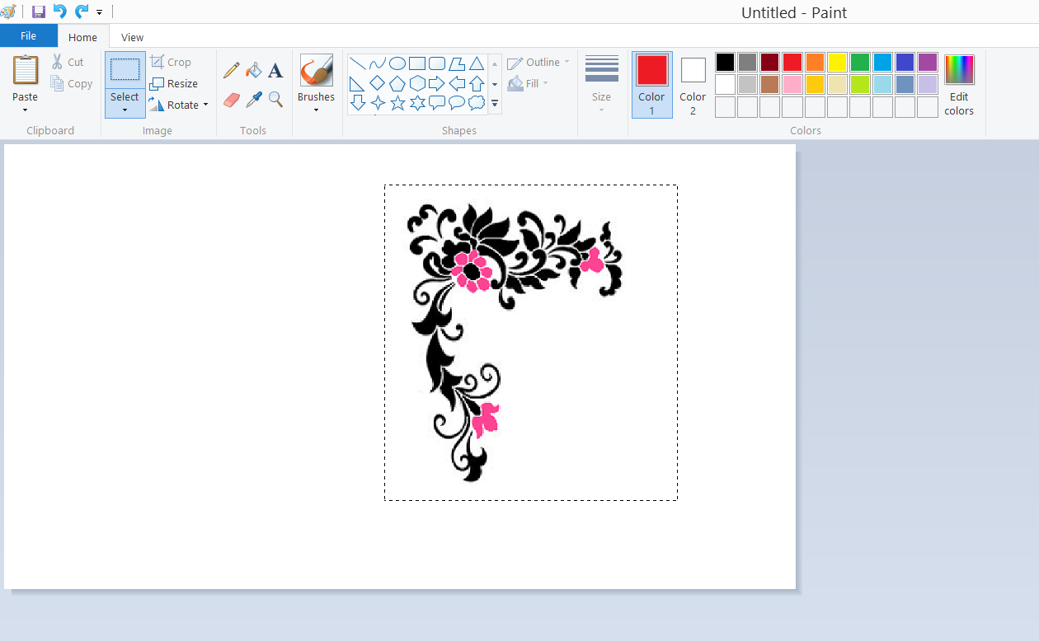
Select Tool
Use Select to select any square or rectangular part of the picture. Click Select, and then, in the options box just below the toolbar, click a background style.
Drag the pointer to select the part of the picture you want to work with.

Slide 6
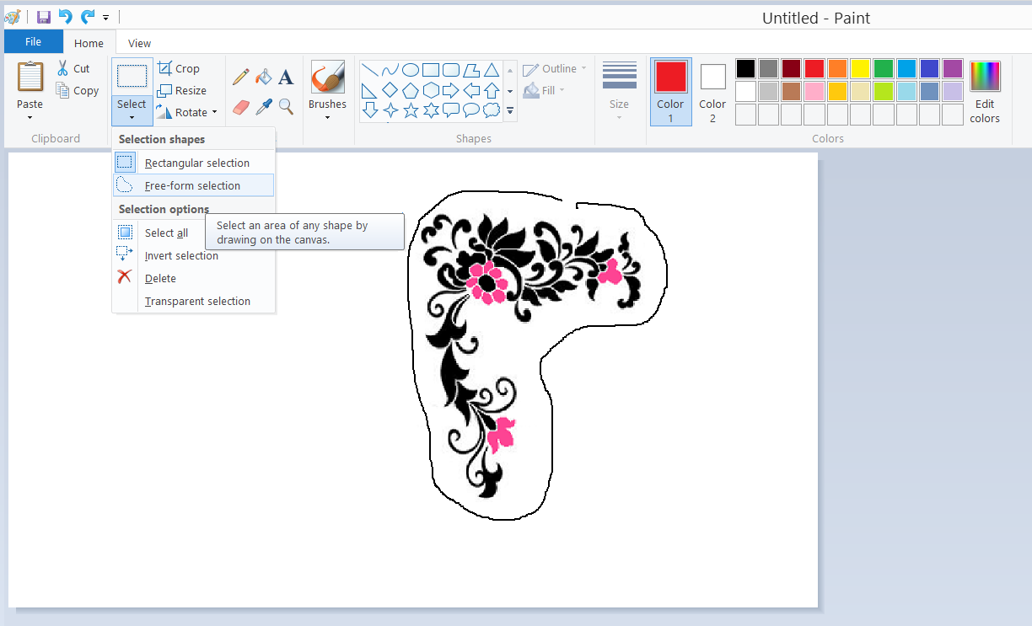
Free Form Select Tool
Use Free-Form Select to select any irregularly shaped part of the picture. Click Free-Form Select, and then, in the options box just below the toolbar, click a background style.
Drag the pointer to
select the part of the
picture you want to
work with.

Slide 7
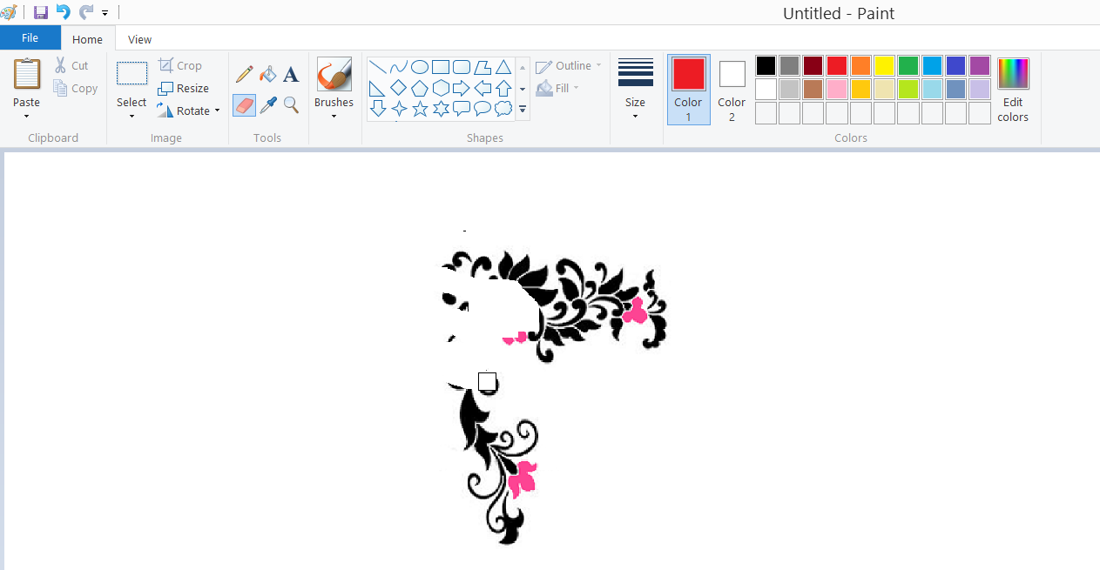
Eraser / Color Eraser Tool
Use the Eraser to erase areas of your picture. Click Eraser, click [ctrl] and [+] to make the eraser bigger and [ctrl] and [-] to make it smaller..
This little square … is your eraser.
Any areas that you erase will be replaced by the background color. Which happens to be WHITE in this case.

Slide 8
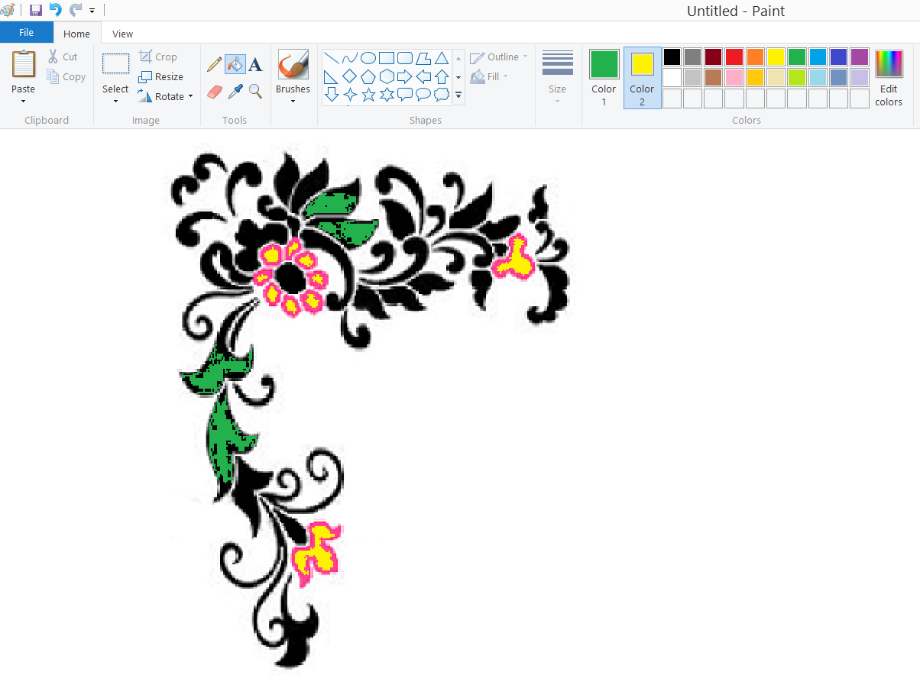
Fill Tool
Use FILL TOOL to fill the entire picture or an enclosed shape with color. Click Fill, click a color in the Color box, and then click inside the area you want to fill.
If you RIGHT click while using the fill tool … you’ll fill with colour #2.

Slide 9
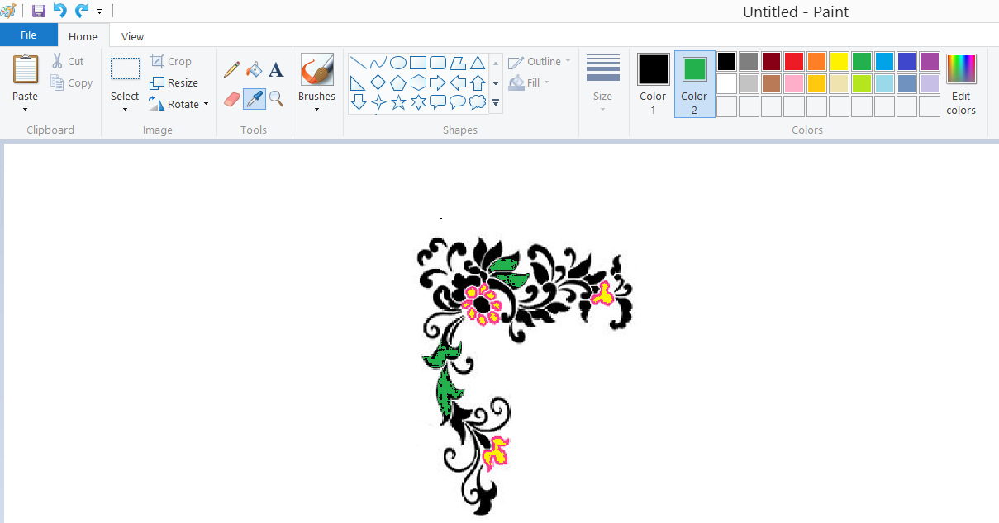
Pick Color / Eye Dropper Tool
Use Pick Color to set the current foreground or background color. Click the ‘eye-dropper’ , and then click the color in your picture that you want to set as the foreground color [colour #1], or right-click the color in your picture that you want to set as the background color [colour #2]. This is useful if your picture has an odd colour in it that you want to copy.
* See how my colour #1 box is now black and not yellow as it was just a second ago. I used the dropper to pick that up.

Slide 10
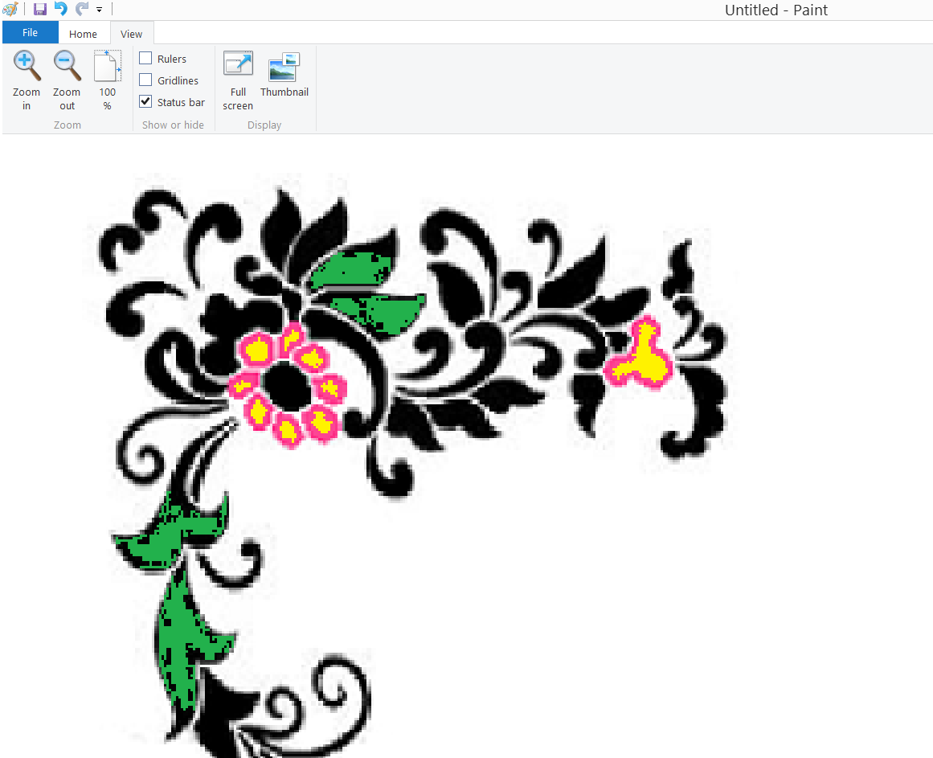
Magnifier Tool
Use the Magnifier to zoom in on a section of your picture. Just hold ctrl and scroll the mouse wheel. Or else, you can click VIEW and then can specify a zoom from there.

Slide 11
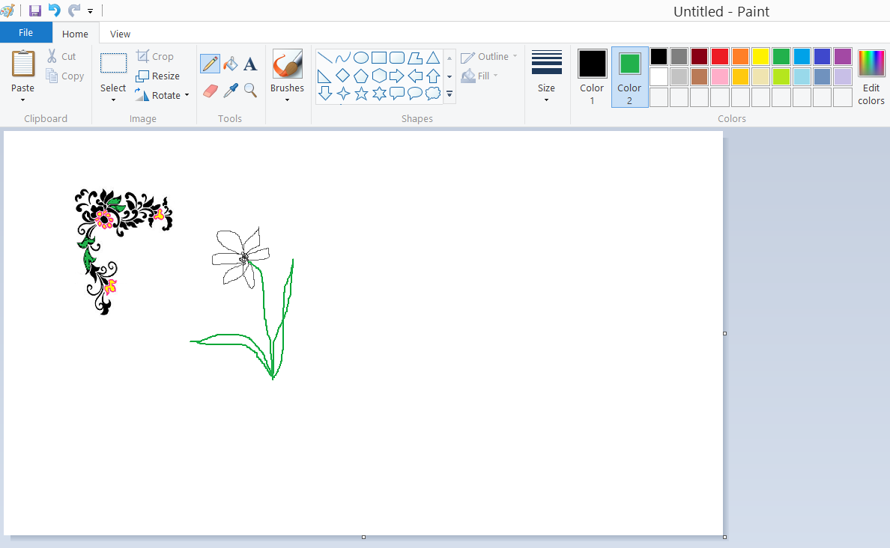
Pencil Tool
Use the Pencil to draw thin, freeform lines or curves. Click Pencil, click a color in the Color box, and then drag the pointer in the picture to draw.
To draw using the #2 color, right-click while you draw with the pointer.
To thicken the line, [ctrl][+]

Slide 12
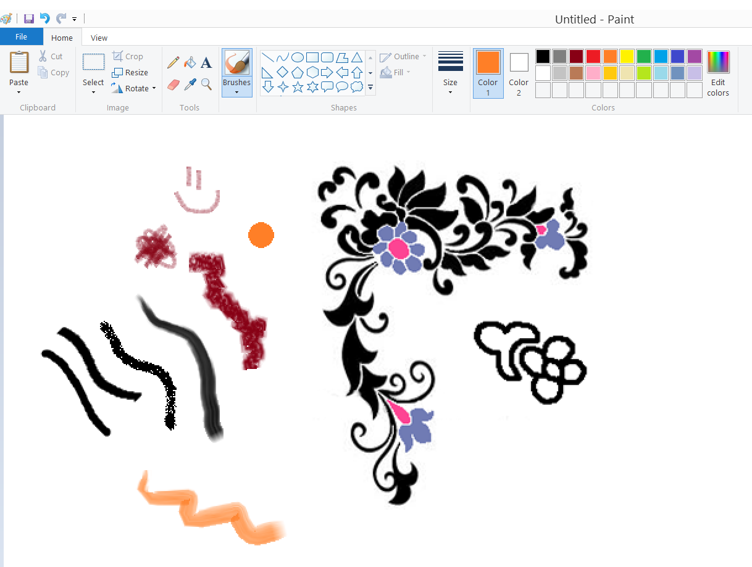
Brush Tool
Use the Brush to paint thick or shaped freeform lines and curves. Click Brush … or the triangle below brush and select a ‘tool’ to draw with., and then drag the pointer to paint.
To paint using the background color, right-click while you drag the pointer.

Slide 13
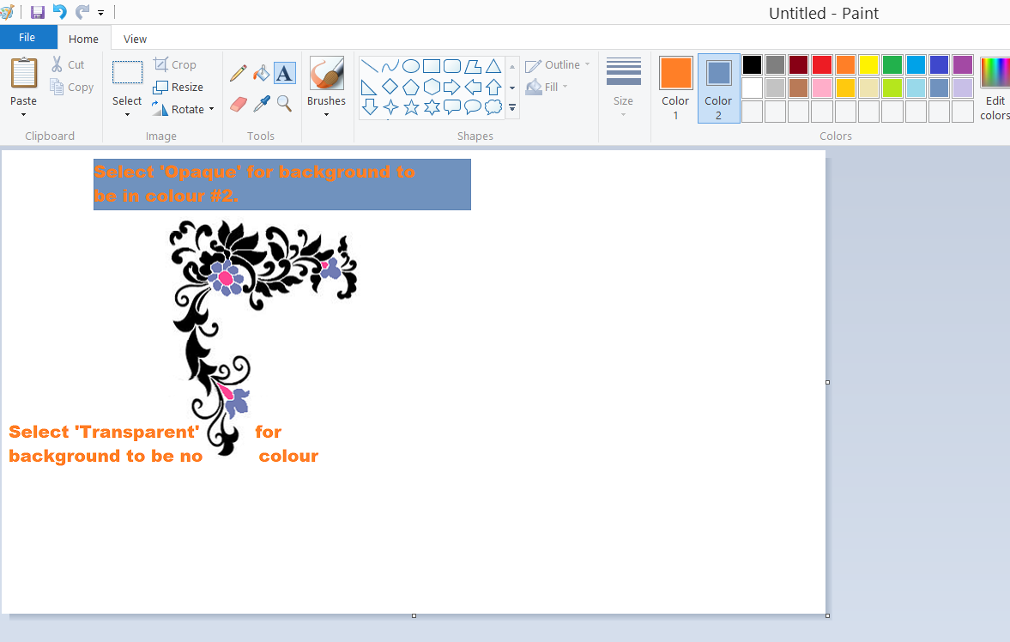
Text Tool
Use Text to enter text in the picture. Click Text, and then, in the options box just below the toolbar, click a background style. Click a color in the Color box, and then click in the picture and type your text.
You can resize and move the text box, and change the font, font size, and text formatting until you click another tool or click outside the text box within the picture. After that it’s part of the picture and unchangeable.

Slide 14
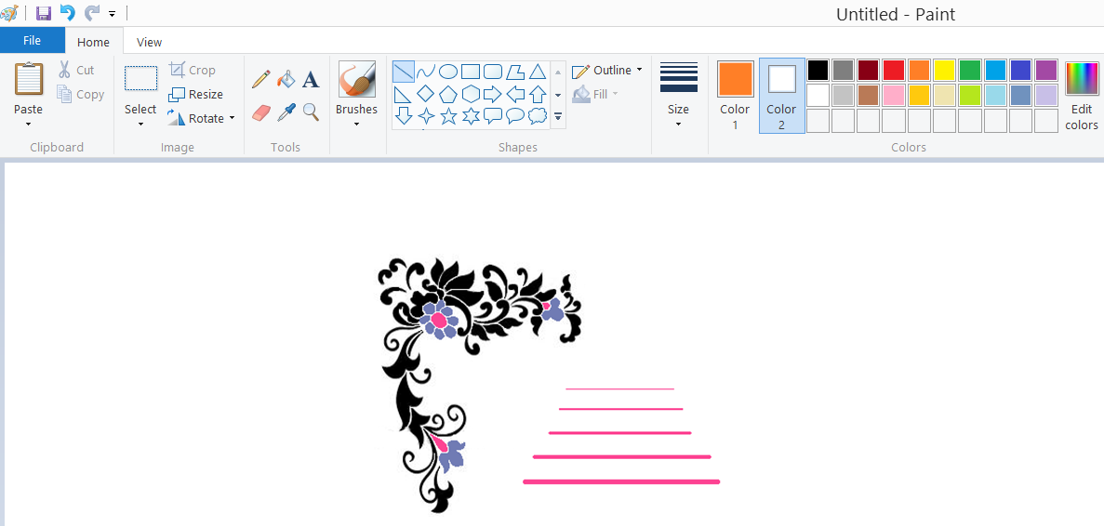
Line Tool
Use Line to draw a straight line. Click Line, click a line width in the options box just below the toolbar, click a color in the Color box, and then drag the pointer in the picture to draw the line.
To draw a line using the background color, right-click while you drag the pointer.

Slide 15
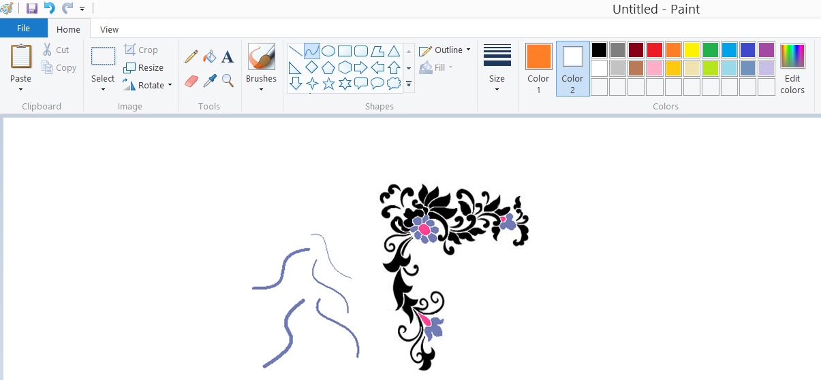
Curve Tool
Use Line to draw a straight line. Click Line, click a line width in the options box just below the toolbar, click a color in the Color box, and then drag the pointer in the picture to draw the line. Click and pull the line twice to make a curve.
To draw a line using the background color, right-click while you drag the pointer.

Slide 16
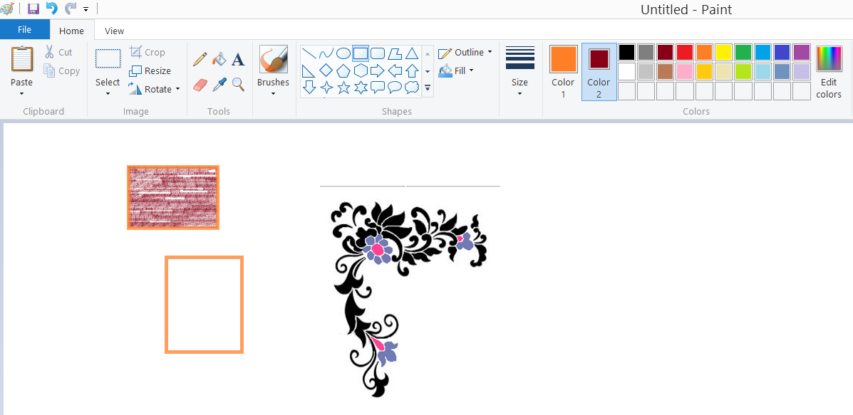
Rectangle Tool
Use Rectangle to draw rectangular shapes. You can select the ‘pen’ for the outline and you can select if you want fill or not --- and what type. ☺
To draw a perfect square, hold down SHIFT while dragging.

Slide 17
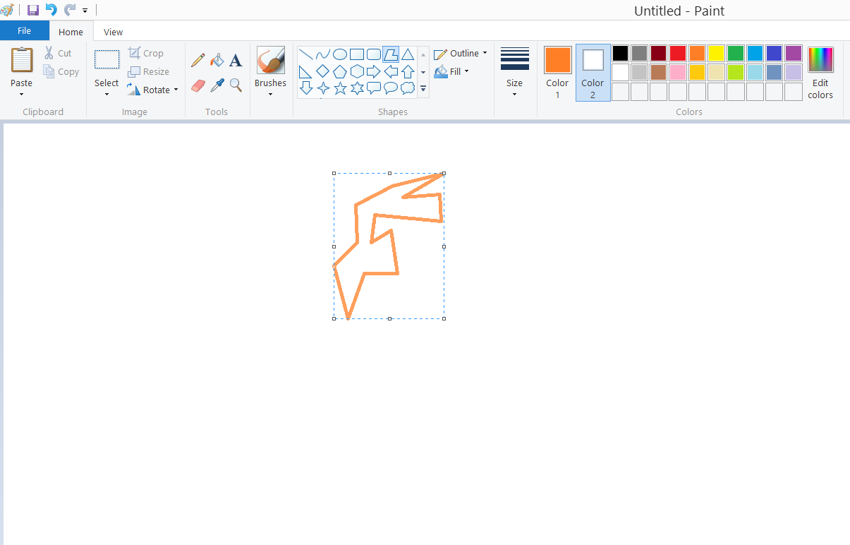
Polygon Tool
Use Polygon to make a shape with any number of sides. Click Polygon, click a color in the Color box, and then click a polygon style in the options box just below the toolbar.
To draw a polygon, drag the pointer to draw a straight line. Then, click each point where you want additional sides to appear. Double-click when you're done.
To create sides with 45- or 90-degree angles, hold down SHIFT while making sides.
You can make lots of shapes. Look at the toolbar.

Slide 18
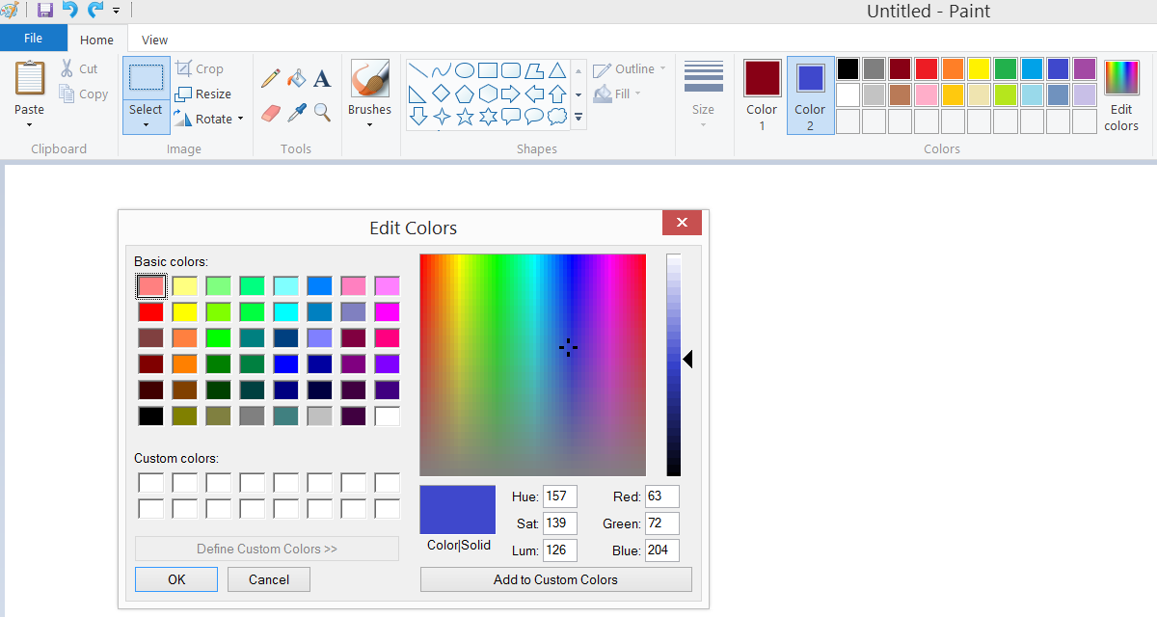
Color Box
The Color box indicates the current foreground and background colors. To choose a color for color #1, select the box that says “Color 1” then click a colour. To choose a colour for #2, select the box with “color 2” and click a colour.
To mix a new color, click “Edit Colors”

Slide 19
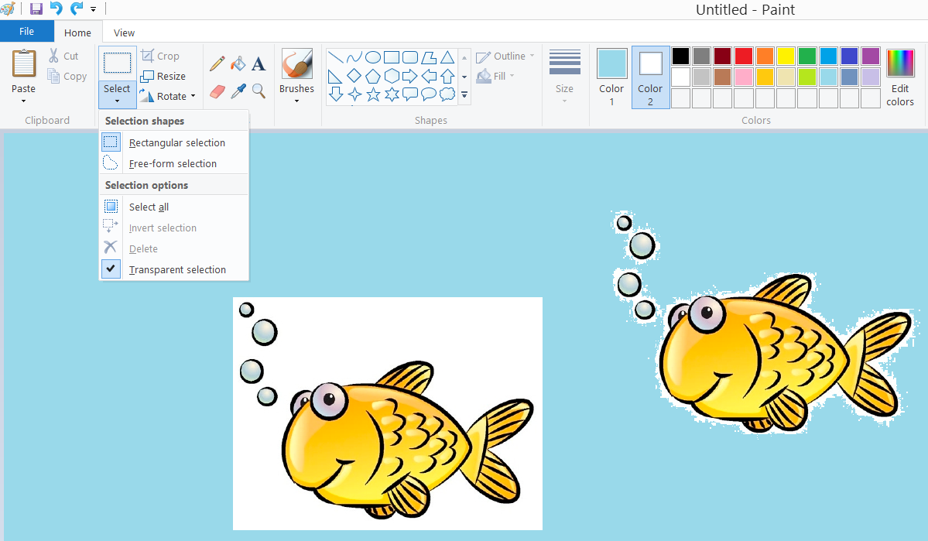
Background Options
Choose Solid Background or Transparent Background when you copy and paste part of a picture using the Free-Form Select or the Select tool. When you use the Solid Background option, the background color is included in your selection when you paste it somewhere else in the picture.
When you use the Transparent Background option, the background color is not included in the selection, so any areas using that color are transparent and allow the rest of the picture to appear in its place.

Slide 20
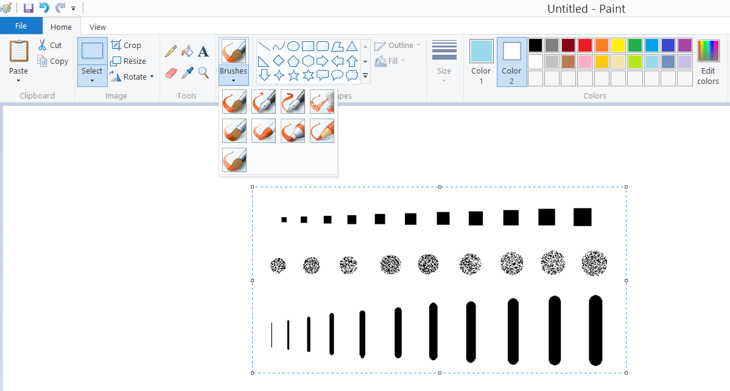
Scaling a Tool
Select a BRUSH tool, hold Ctrl and hit the + button on the numpad. The brush size will grow as big as you need.

Slide 21
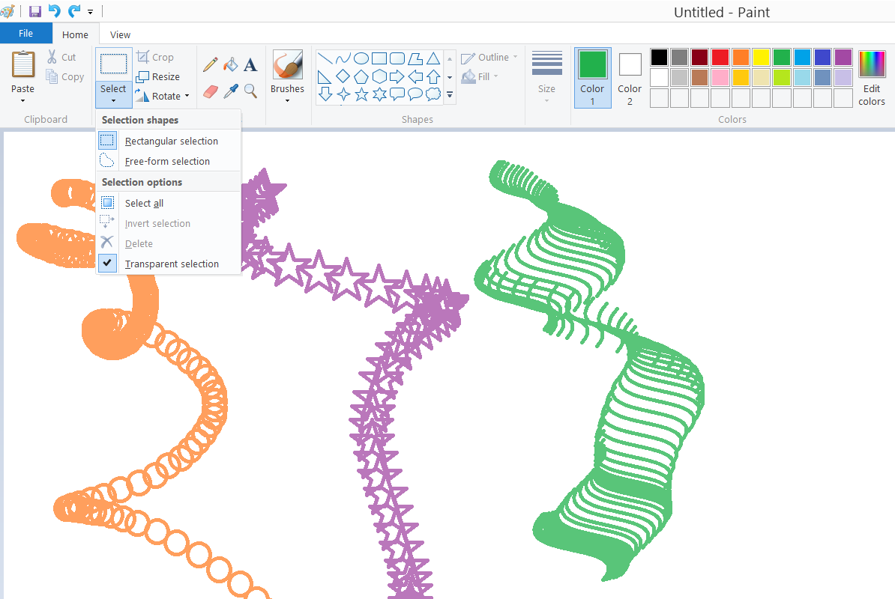
Custom Brushes
Select any tool and draw a small textured brush in any color. Now, select that little image, turn transparency on, hold shift, and drag it around.

Slide 22
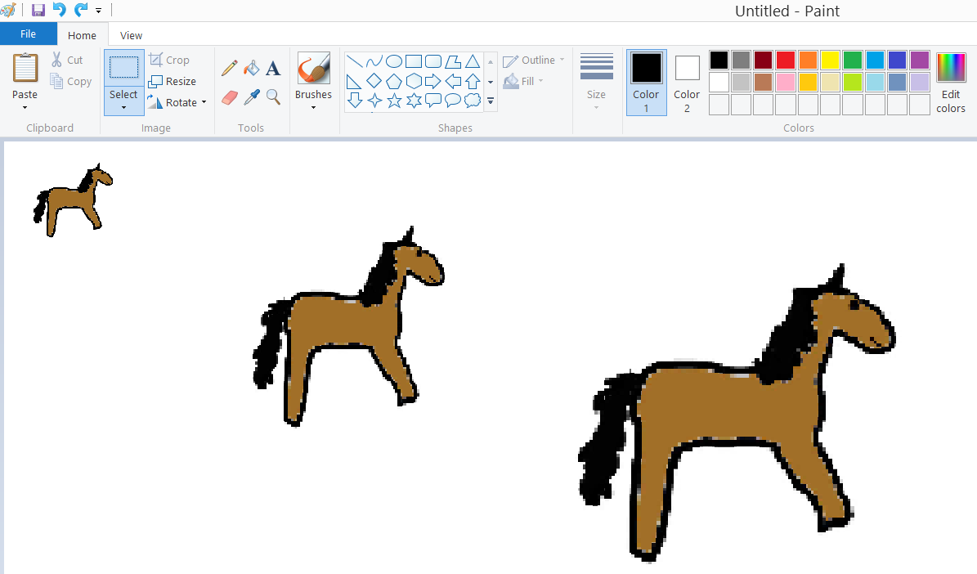
Resizing an Image
Open paint and paste your image in. Hit Ctrl + Plus (Numpad) to make it larger or Ctrl + Minus (Numpad) to make it smaller.

Slide 23
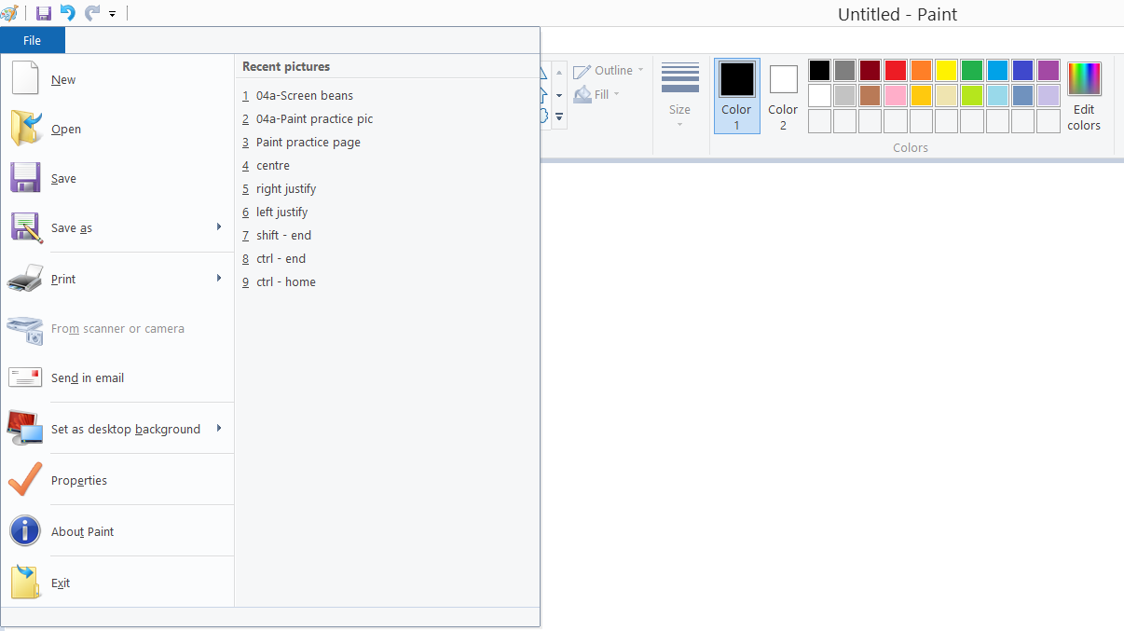
File Menu
This is where you’d go to create a new file, open a file, save a file, or print a file.
LOOK!! You can set your picture as desktop background!

Slide 24
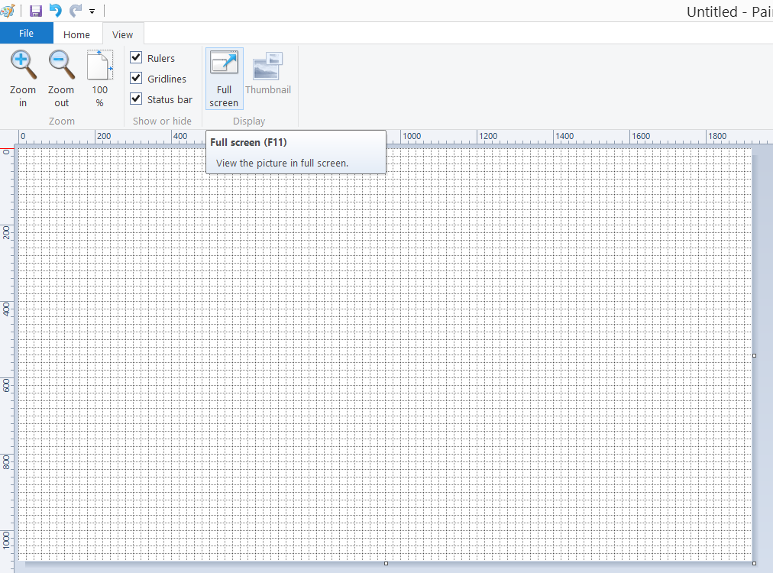
View Menu
The VIEW Menu is where you’ll find Zoom and a few other things. Though you can zoom using mouse wheel and ctrl key.
I turned ON the gridlines and ruler, just so you can see it here.
Full Screen just makes you see the picture taking up your entire screen. If you click it … just click again to get back to original ‘edit’ view.

Slide 25
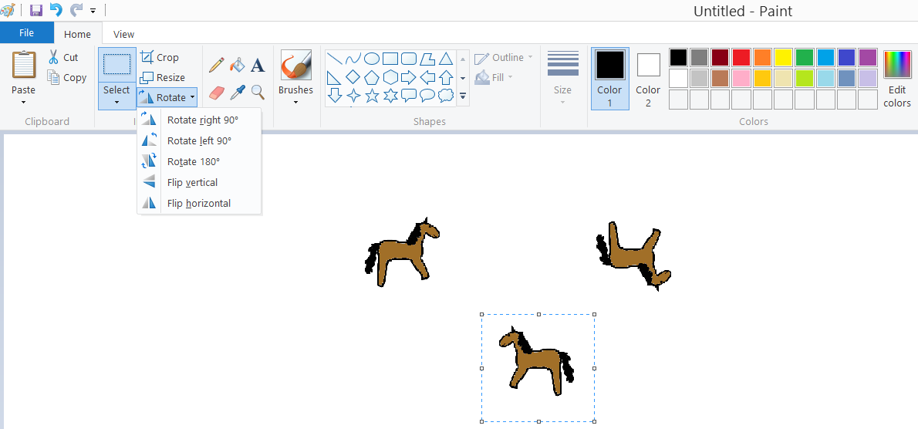
Rotate
Rather obvious. But limited in that you can only rotate through specific degrees. HOWEVER, from there, you can select and paste your picture into MS Word and rotate it however much you need. So it is still useful enough.
Flip / Rotate: Flips or rotates the picture or selection.
Resize / Skew: Resizes or skews the picture or selection.

Slide 26


Crop button
Trims the current image to contain only what is currently selected. This is IMPORTANT because if you save, without cropping, your picture will always have all the extra white space.
Select your area first … then click CROP.
You could end up with this picture
Instead of this picture

Slide 27
Conclusion
Even though MS Paint is a very limited graphics program, it is perhaps the most useful tool for introducing new users to working with graphics programs. Much of what we have learned in using Paint can be usefully applied to learning to use other, more sophisticated graphics programs.
While older versions of MS Paint were capable of working only with the .bmp file format, Paint currently handles a variety of image formats, including of the commonly used formats such as JPEG and GIF. This makes Paint appreciably more flexible for working with images and converting from one file type to another.
If all you need is a very basic image editor, Paint is a pretty good choice. Its greatest feature, other than its simplicity, is the fact that Paint is distributed freely with the Microsoft Windows operating system.
Now that you are familiar with paint, you can try making your images or art work.
Assignment: Complete Business Storefront Project

