Slide 1
Power Point Tips

Slide 2
Anesthesiologist
Title Slide example:
Career Title and Student’s Name
Notice font color contrasts the background color. This means that the font is easily read and seen on the slide.
Theme is applied to slide.
Presentation by Student’s name

Slide 3
DESIGN TIPS
Do not use short or long paragraphs in a Power Point. Your audience will not take the time to read paragraphs.
An anesthesiologist is in charge of administering anesthesia to a patient so they will be pain free during their surgery. They care for their patients before, after, and during the surgery. They have to evaluate their patients before surgery so they will know which anesthetic to give them. https://www2.careercruising.com/careers/job-description/557

Slide 4
More in Depth Description
After an anesthesiologist discusses the patient's medical history with the whole team of surgeons to determine which anesthetic is best for them, then they must talk to the patient about the drugs they are going to use so they know what to expect. They also check the patient for good blood pressure and a strong heart rate. After that they give either a general anesthetic ( makes the patient unconscious) or a regional anesthetic ( only numbs part of the body). While the surgery is going on anesthesiologists monitor the patient and watch for any changes in the patient. They check the patient’s heart rate, breathing, and blood pressure. The also can change the amount of anesthesia that is being administered to the patient to control their level of consciousness. The take charge of the pain control of the patient so the surgeon can focus on the procedure they are performing. After the surgery is completed, they make sure that the patient wakes up from the surgery without a problem. At this point they may also prescribe the patient pain medications. An anesthesiologist may specialize in one field such as chronic pain or cardiovascular anesthesia. They will most likely work in the pain management section of a hospital or in specialty clinics. An anesthesiologist often works as part of a team with other healthcare workers to find ways to lessen the pain the patient will feel. https://www2.careercruising.com/careers/job-description/557

Slide 5
DESIGN TIPS
Use bullets or numbering
Use short descriptive words/phrases/sentence
Focus points in presentation
Speaker and audience

Slide 6
DESIGN TIP: KNOW WHAT YOU ARE GOING TO FOCUS ON FOR EACH SLIDE
Renwick
Doreen
7:30-8:00 she prepared for the first surgery of the day.
From 8:00-11:00 she gave the patient anesthesia and monitored them during the whole surgery.
11:00-11:30 she woke the patient up by taking them off the anesthesia an monitored them until they went back to normal
12:00-2:30 she repeated the same process as earlier for a second surgery.
2:30-3:30 she rushed to see an emergency patient.
3:30-4:30 she monitored and diagnosed the patient, then sent them into surgery.
4:30-6:30 she taught a group of medical students.
8:00-9:00 he consulted his first patient of the day.
9:00- 9:30 he set up the equipment for the first surgery
9:30-11:00 he gave the patient anesthesia and monitored them throughout the whole surgery.
11:00-12:00 he took the patient to the recovery room and told the staff what to look out for.
12:00-1:00 the second operation starts and he administers anesthesia and monitors the patient throughout the surgery.
1:30-2:00 he took the patient back to the recovery room
2:00-4:00 he repeats the same process for a third surgery
4:00-5:00 he reviews the charts of patients and prepares for the next day
6:00-7:00 he goes home and eats dinner
https://www2.careercruising.com/interviews/a-day-in-the-life/557/anesuDo
https://www2.careercruising.com/interviews/a-day-in-the-life/557/anesuRe

Slide 7
DESIGN TIPS
FONT:
Style: Different styles for titles and informational text
Size: Use appropriate sizes for titles and informational text
Color: Should contrast(opposite) your background
Readable: All text should be visible and readable

Slide 8
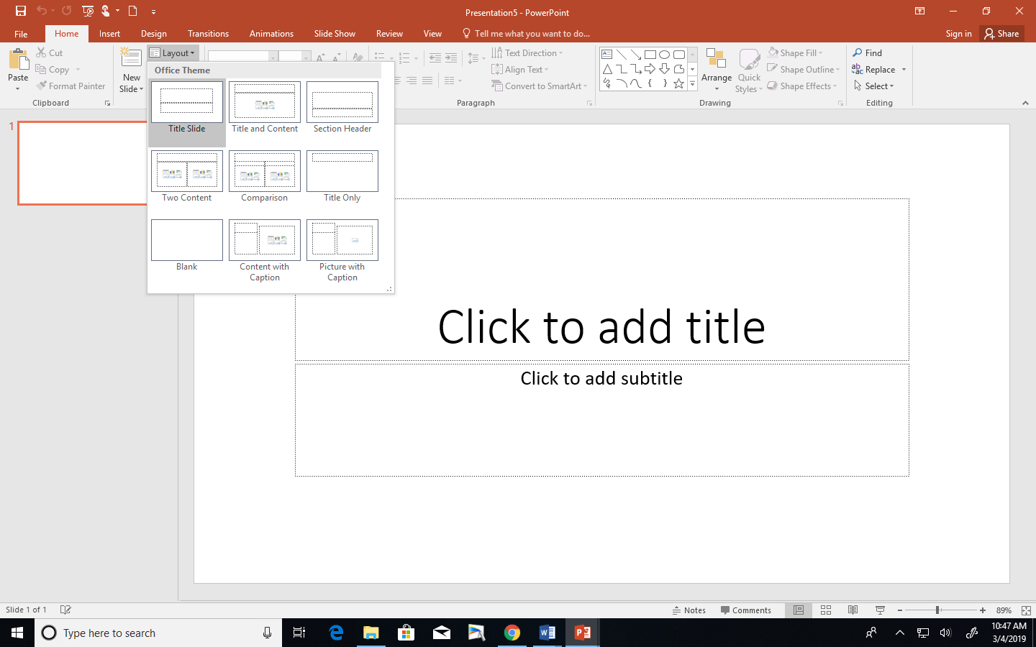
Slide Layouts
Use different slide layouts in your presentation
Different Themes may have different slide layout choices

Slide 9
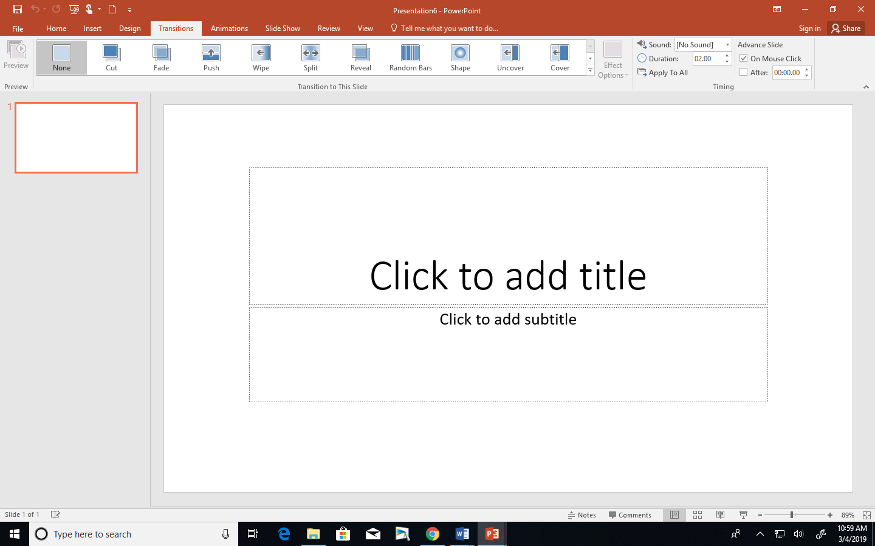
Transitions
Use to move from one slide to the next when your focus has changed.

Slide 10
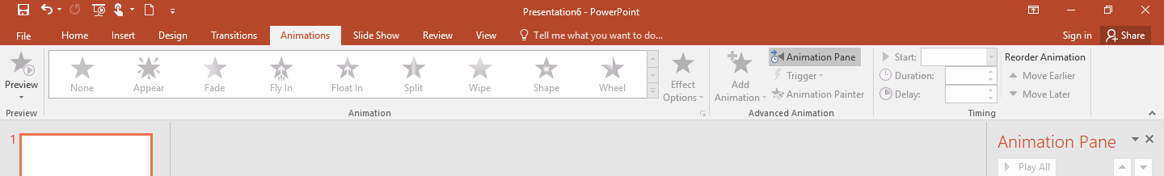
Clip Art
Use clip art to emphasize main points
Should relate to main points on slide
Use it sparingly
Do not over use clip art!

