Slide 1
Canadian Train tours
By Region

Slide 2
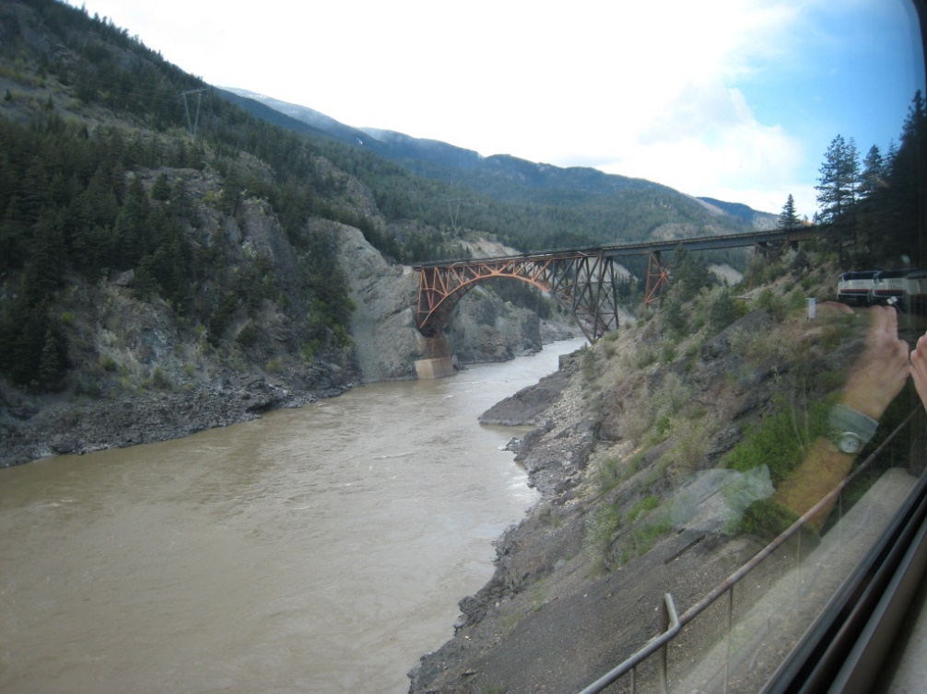
Trans Canadian Luxury Tour
10 nights/12 days
Departure cities
  Toronto, ON
  Ottawa, ON
Destination city – Vancouver, BC
Prices
  $3560 – Toronto, ON
  $3250 – Ottawa, ON

Slide 3
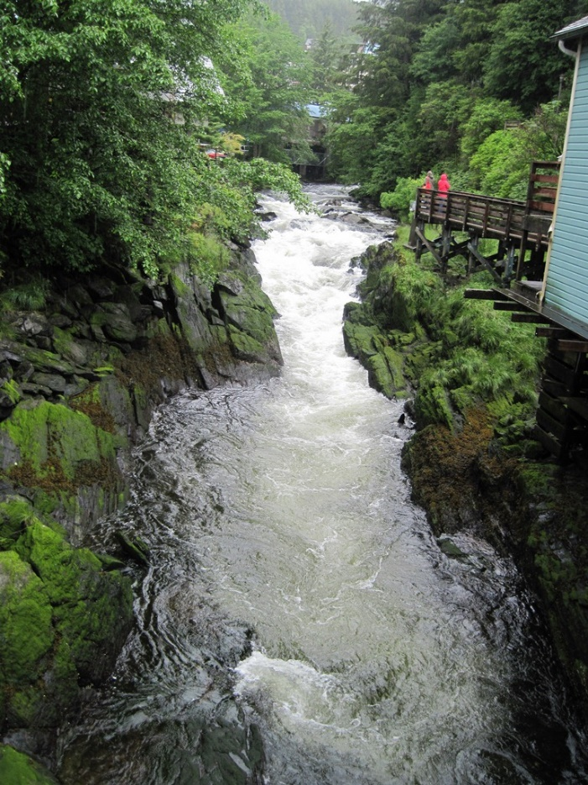
Interior Ontario Tour
2 nights/3 days
Departure city – Sudbury, ON
Destination city – White River, ON
Price
  $210

Slide 4
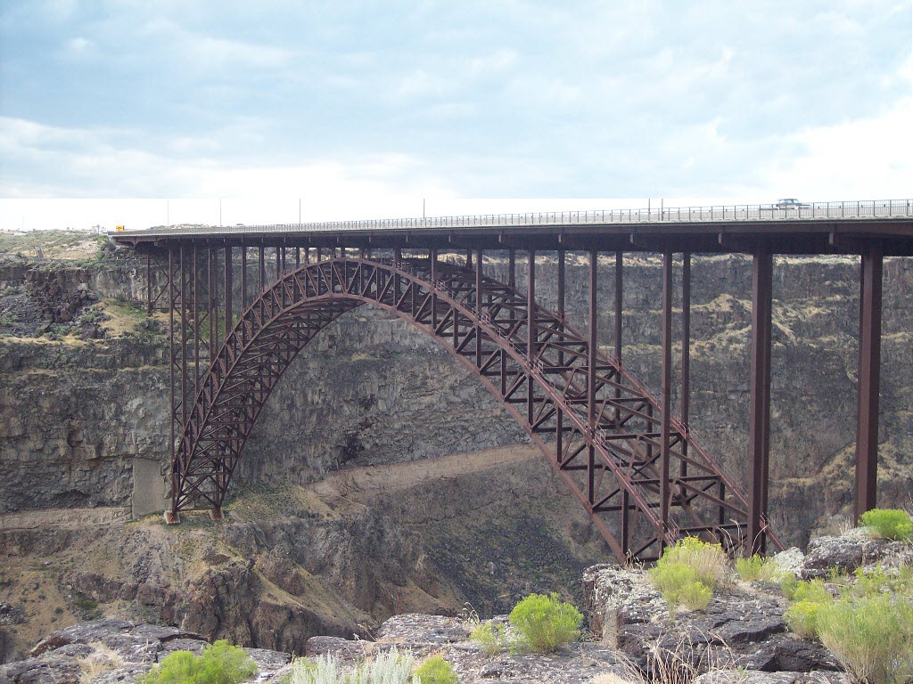
Northern Quebec Tour
2 nights/3 days
Departure city – Montreal, ON
Destination city – Senneterre, ON
Price
  $210

Slide 5

Manitoba Tour
3 nights/4 days
Departure city – Winnipeg, MN
Destination city – Churchill, MN
Prices
  $380
Stops include The Pas and Pukatawagan

Slide 6
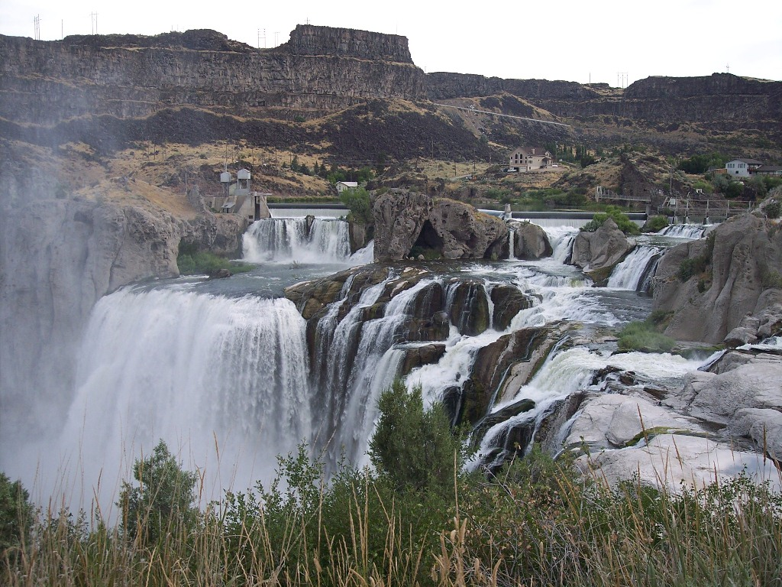
Southern Ontario Tour
3 nights/5 days
Departure cities
  Montreal, QC
  Ottawa, ON
Destination cities
  Windsor, ON
  Niagara Falls, ON
Prices
  $320
  $380

