Slide 1
My (Potential)Future Career- Image Consultant
Student Name

Slide 2
Why I Chose This Career
I chose this career because it relates to what field I plan on going into. I plan on earning a degree in cosmetology, and in this career, cosmetology is helpful to have knowledge in. This career also helps people present themselves better in a professional environment, and I like helping others.

Slide 3
Job Description
Image consultants help people present their best image socially, physically, and digitally. They offer advice on posture, manners, and public speaking.
Image consultants are generally self employed, but they may work for large companies. Consultants usually specialize in a certain area, such as clothing, makeup, hair styling, or social etiquette.
Image consultants spend a majority of their time trying to get their name out and advertise their business. Image Consultant must have experience in Marketing in order to successfully advertise their business.

Slide 4
Working Conditions
Image Consulting allows flexible hours, (depending on the client) and working on the weekends may be required to meet clients’ needs.
Image Consultants usually work at home, so an office space is needed, but some may work with a large company who provides an office space.
Traveling to meet clients, or traveling to help the client shop may be needed, so a mode of transportation is required.

Slide 5
Education and Training
Education
Training
There are no specific classes in high school to study on how to be an image consultant, but there are colleges.
A college in New York called The Fashion Institute of Technology State University of New York can help you earn a degree in Image Consulting.
Suggested classes are cosmetology, fashion, and design.
The AICI (Association of Image Consultants International) does have training programs through their links on their website, and they also have training sessions in certain areas.

Slide 6
Suggested High School Classes
Some suggested high school classes are cosmetology, business management, fashion, and visual arts.
The Gratiot County GI-TEC Center does have some classes that could relate to this job, and Alma High School has electives that could help you prepare to be an image consultant.
AHS has Advanced Business Technology, and Visual Arts classes, while Mt. Pleasant’s GI-TEC has a Cosmetology program at MJ Murphy Beauty College.

Slide 7
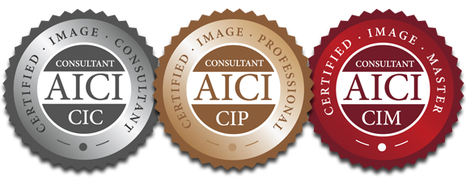
Colleges That Have Related Programs
The Fashion Institute of Technology State University of New York
This institute provides certification to be an image consultant, and also provides degrees and certification in other fields other than image consulting.
The Association of Image Consultants International (AICI)

Slide 8
Info From the Interview….
According to the interview with Rinat, this field’s job security really depends on how well you advertise your business, and as long as you are advertising yourself and providing a quality experience for the client, you’ll be successful.
In the interview with Manfred, he suggested starting out with a small or large company, then branching out to different opportunities, eventually starting your own business.

Slide 9
Job Outlook
In a similar career field, cosmetology and hair services, is projected to grow 13% from 2016 to 2026, which is faster than the average for all occupations.
Overall job opportunities are expected to be good, and a large number of jobs will come from the need to replace workers who transfer to other jobs, retire, or leave the job for other reasons.
Workers should expect high competition for jobs and clients at higher paying salons, which are few, so there is high competition between experienced cosmetologists and hairstylists.

Slide 10
Salary
Just starting out, you may be able to charge $20-30 dollars an hour.
People in high demand can earn $500 in a big city. Some can even charge $2000 an hour.
The annual income for full-time consultants ranges from around $30,000 to $100,000 or more.
The median income is around $50,000 a year

Slide 11
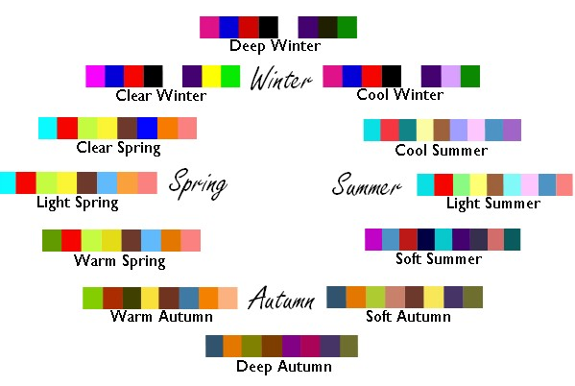
A Typical Day on the Job
After calling and setting up appointments with future clients along with advertising, the consultant meets the client, and has a consultation to learn their needs and concerns.
After talking with the client, a plan is made, and services are determined. The service may include a color analysis.
The client’s wardrobe may be edited based on the analysis, and a shopping list is made, along with scheduling coaching lessons.
After the list is made, there is a personal day of shopping.

Slide 12
Sample Career Path & Related Careers
Sample Career Path
Level 1
Retail Clothing Store Clerk
Earnings: $15,000- $30,000 a year
Level 2
Image Consultant at a Fashion Boutique
Earnings: $30,000- $50,000 a year
Level 3
Freelance Image Consultant
Earnings: $30,000- $100,000 a year
Related Careers
Career Counselor
Casting Director
Cosmetologist
Fashion Designer
Fashion Retailer
Makeup Artist

Slide 13
Attire and Work Skills Necessary
The following skills are necessary to be a successful Image Consultant:
Communication, listening, and persuading.
The ability to use computers.
The ability to plan, budget, organize, and manage time
Awareness on how colors, shapes, and patterns are used in a design
An enthusiastic personality, and an eager attitude
Leadership skills
Experience in Marketing
Professional, business wear attire is needed for this career

Slide 14
Surprising Things I’ve Learned
I found that most of my sources state that starting out in a large company will help gain consulting experience. Yet, when looking into more sources, they state that it may be harder to work in a large company due to the fact that not many companies offer this service.
I also learned that to be an image consultant, it is a hard field to break into. You generally have to start out with some sort of experience, then work your way up to becoming certified in image consulting.

Slide 15
Here’s an Image!
http://4.bp.blogspot.com/-_OsA4_fSKAw/VT2_bJmckzI/AAAAAAAAAHg/2TbO8XrC4aE/s1600/Fashion%2BConsultant.jpeg

Slide 16
Sources
https://www2.careercruising.com/careers/job-description/525
https://www.myworldofwork.co.uk/my-career-options/job-profiles/image-consultant
https://www.bls.gov/ooh/personal-care-and-service/barbers-hairstylists-and-cosmetologists.htm#tab-6
https://www.aici.org/events/event_list.asp
https://jobshadow.com/interview-with-an-image-and-fashion-consultant/
https://studioforimageprofessionals.com/how-to-become-an-image-consultant/
https://study.com/articles/How_to_Become_an_Image_Consultant_Education_and_Career_Roadmap.html
http://www.thechicfashionista.com/your-best-perfect-colors.html

