Slide 1
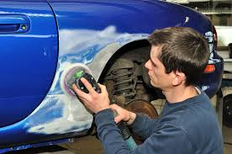
My Career
Student name

Slide 2
Auto body repairer Description
When customers bring in their cars there usually wrecked or something
They give their customer an estimate of how much the damage is
They explain to the costumer what needs to be done
How long it will take to repair it
Frame and unibody repair, refinishing and painting, door and fender repair, glass installation

Slide 3
Working Conditions
It’s usually loud due to banging hammers against metal and the whir of power tools
Most repairers work a standard 35 to 40 –hour week. Over time and weekend work may be required during busy periods.
Repairer spend most of there time on their feet.
They have to bend, kneel, reach, and stretch to complete some repairs. Most of their work is strenuous and dirty.

Slide 4
Education
Programs are offered all over the country
Includes high school, trade, school, and 2 year colleges

Slide 5
Training needed
You have to complete a formal training program or get informal, on the job training.

Slide 6
Suggested high school classes
Auto collision technology
Auto detailing and reconditioning
Auto repair technology
Industrial arts
Introduction to mechanics
Metalworking
welding

Slide 7
Salary
On an average you make between 25,000 and 71,000 dollars a year, but it depends what you do.

Slide 8
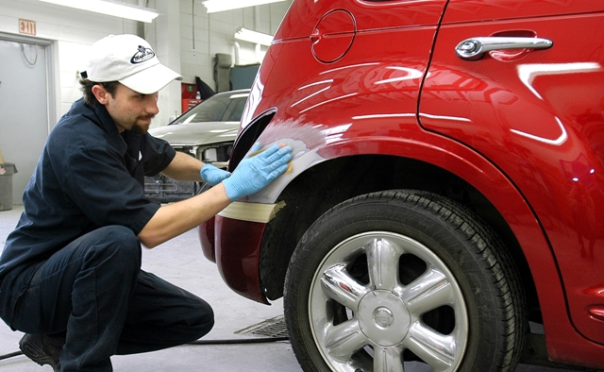
A typical day on the job
Long
Hard
Tiring
Can be fun when you want it to be

Slide 9
Attitudes necessary for this job
You have to tell yourself that you can do it
Just do it
Its easier when your done

Slide 10
Something I learned when researching this job
I found out that this job pays better than what I thought
You have to be seriously careful

Slide 11
Pictures in Action

Slide 12
Sources
https://apps.il-work-net.com/cis/clusters/OccupationDetails/100248?parentId=111600&section=courses&sectionTitle=Helpful%20High%20School%20Courses
https://www2.careercruising.com/careers/sample-career-path/43

